Slide 1
Use this image as first introduction image

Slide 2
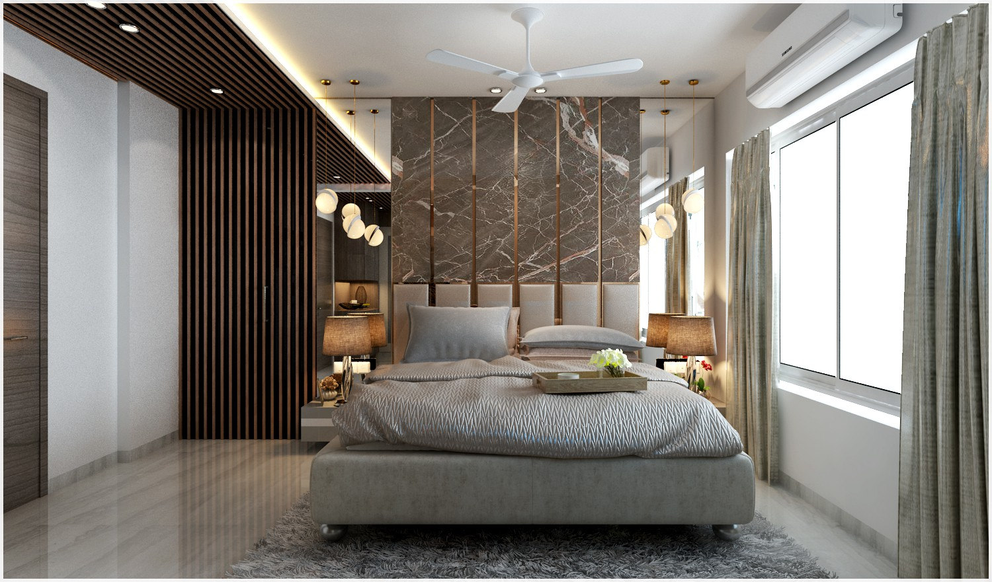

Slide 3
PROJECT 1

Slide 4
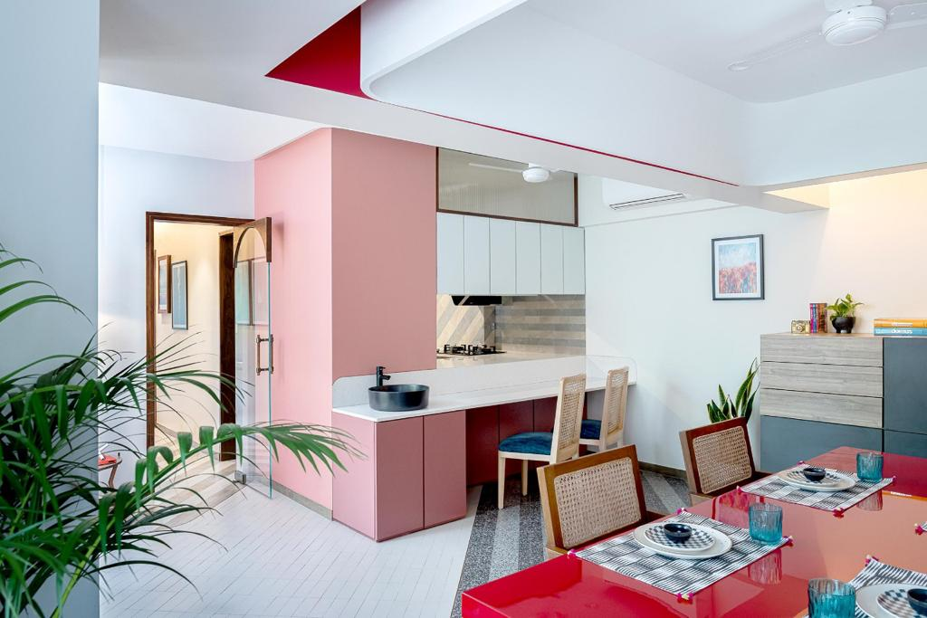

Slide 5
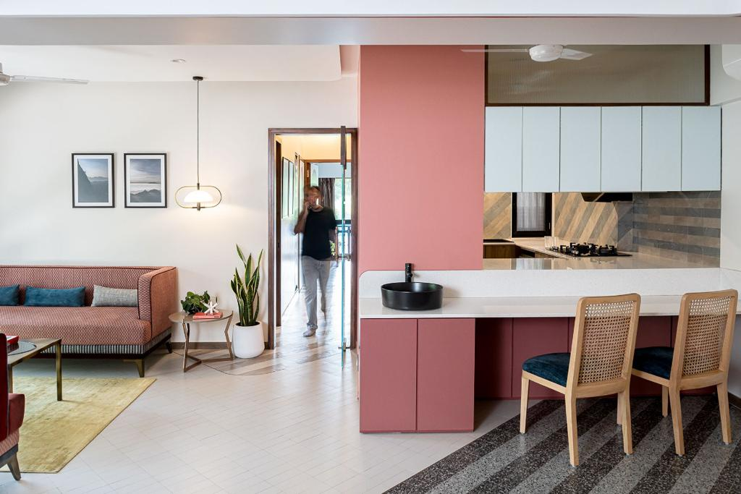

Slide 6
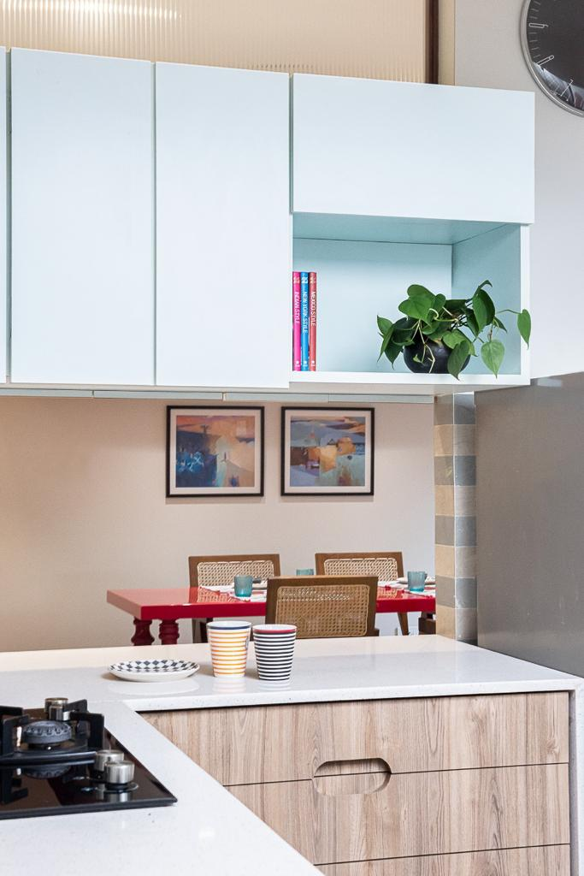
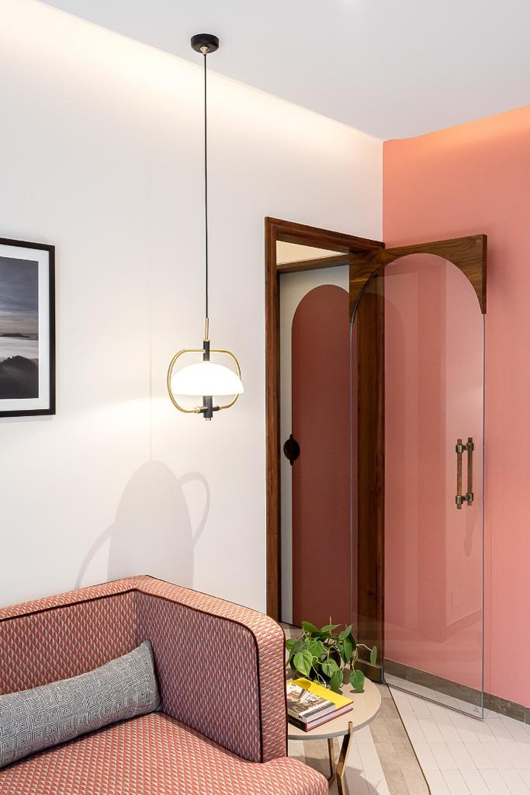

Slide 7
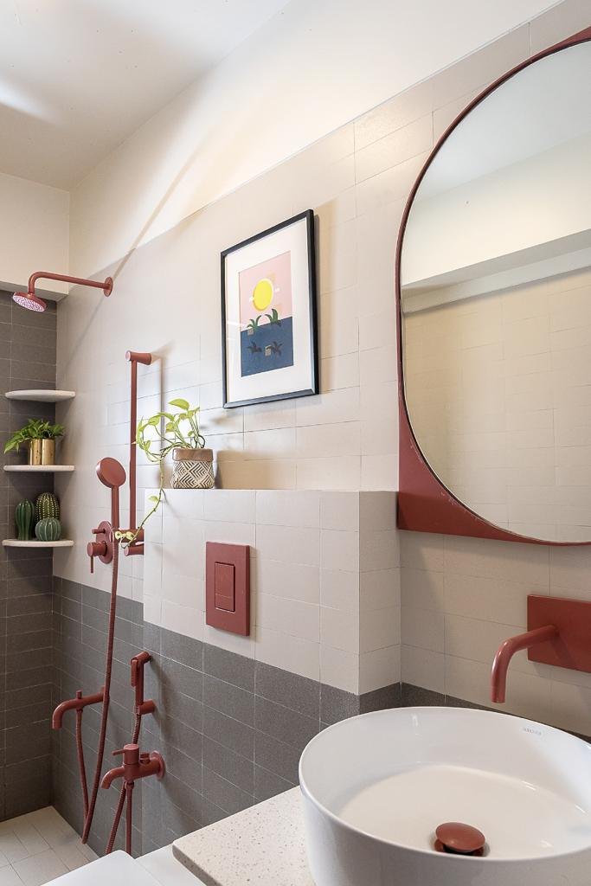
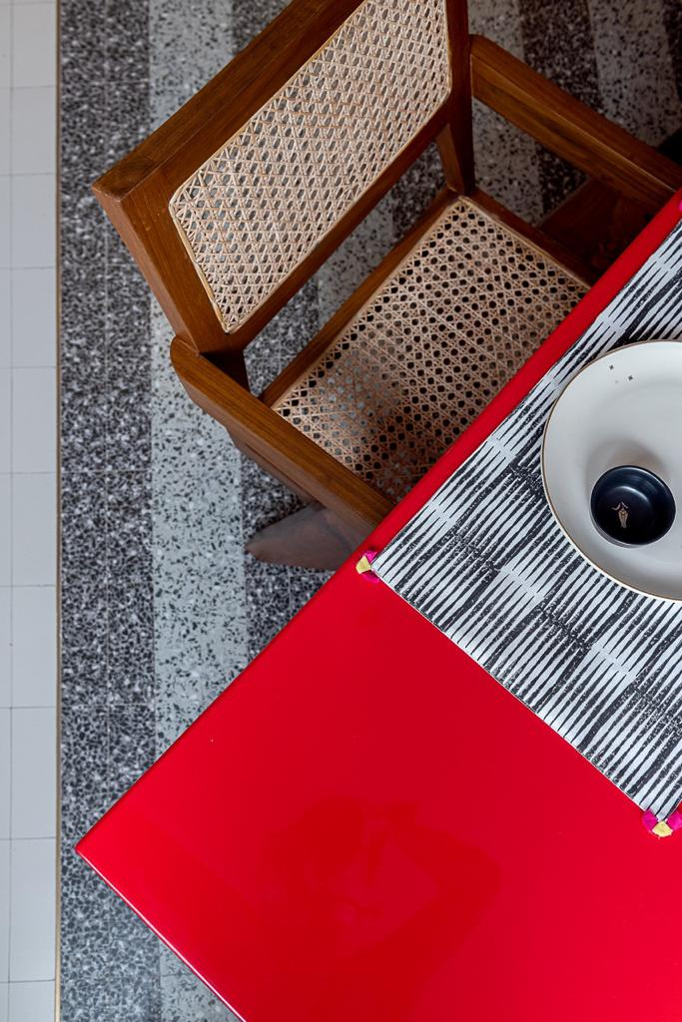

Slide 8
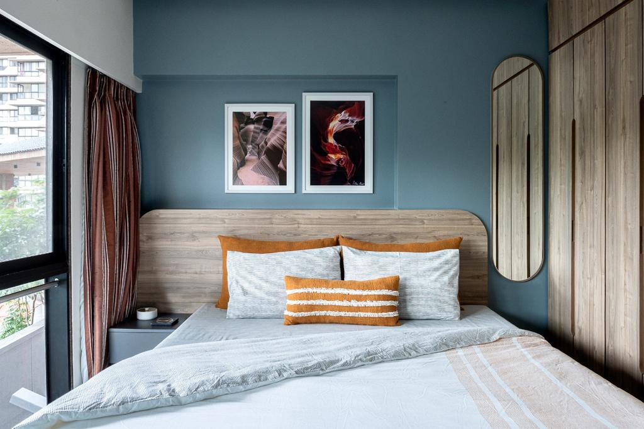

Slide 9
Contemporary Bedroom Design A refined blend of modern aesthetics and functional comfort, this bedroom features a sleek wooden headboard, neutral bedding with bold accent pillows, and a sophisticated blue-gray wall with abstract art. Natural light, a built-in wardrobe, and minimalist details make it a perfect example of residential interior design that is both stylish and practical. this design highlights Kalasaar’s expertise in creating spaces that are both functional and visually captivating.

Slide 10
PROJECT 2

Slide 11
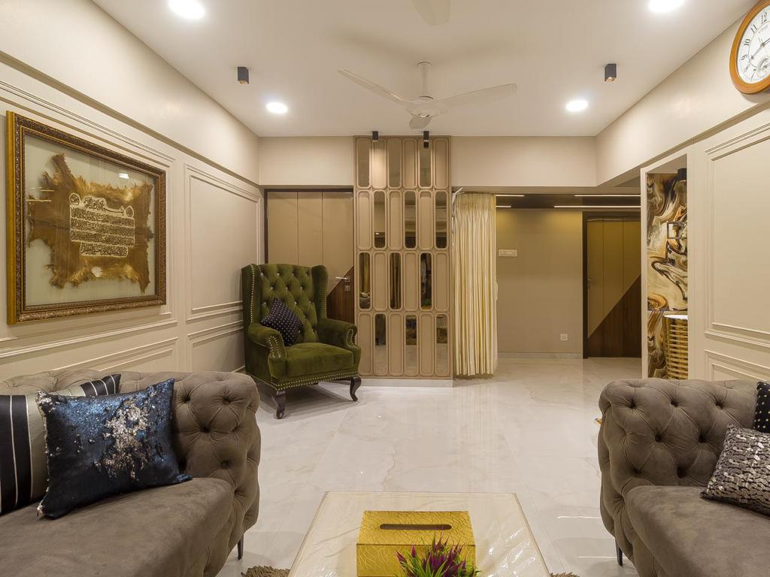

Slide 12
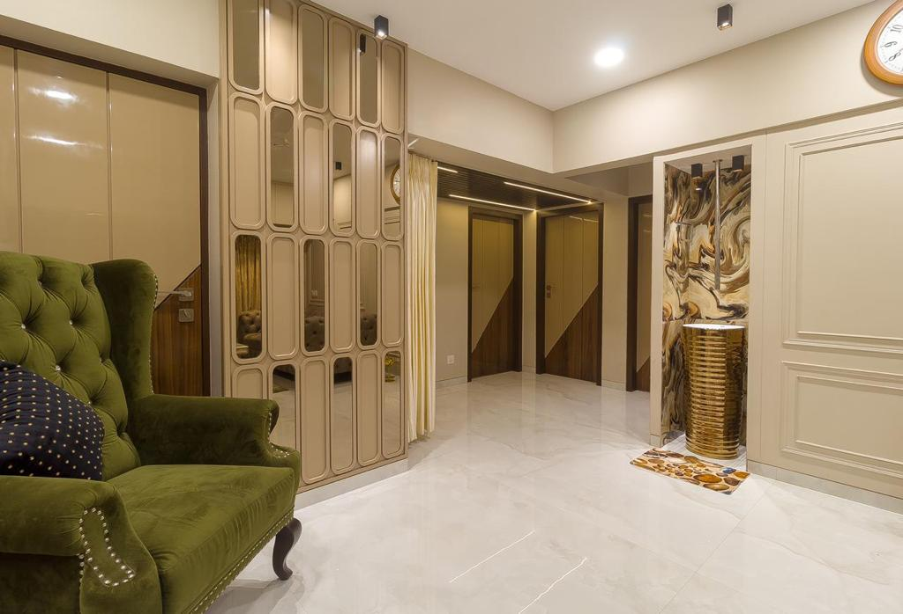

Slide 13
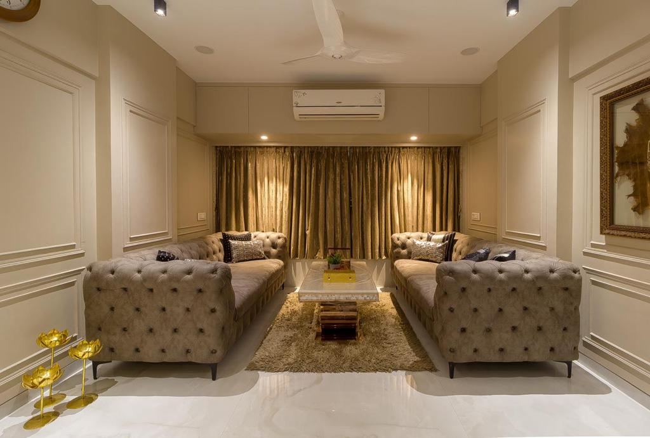

Slide 14
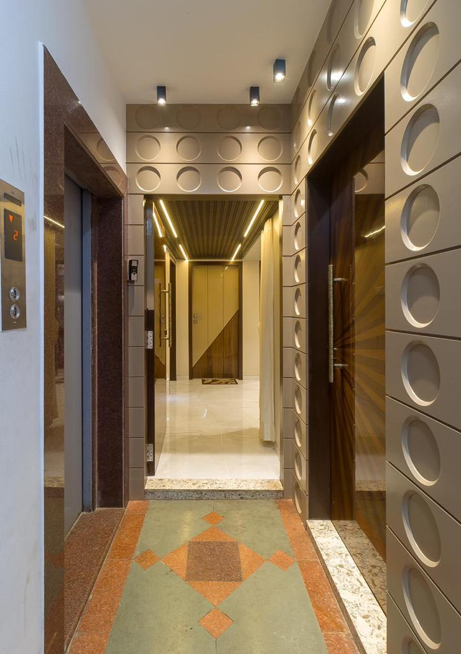
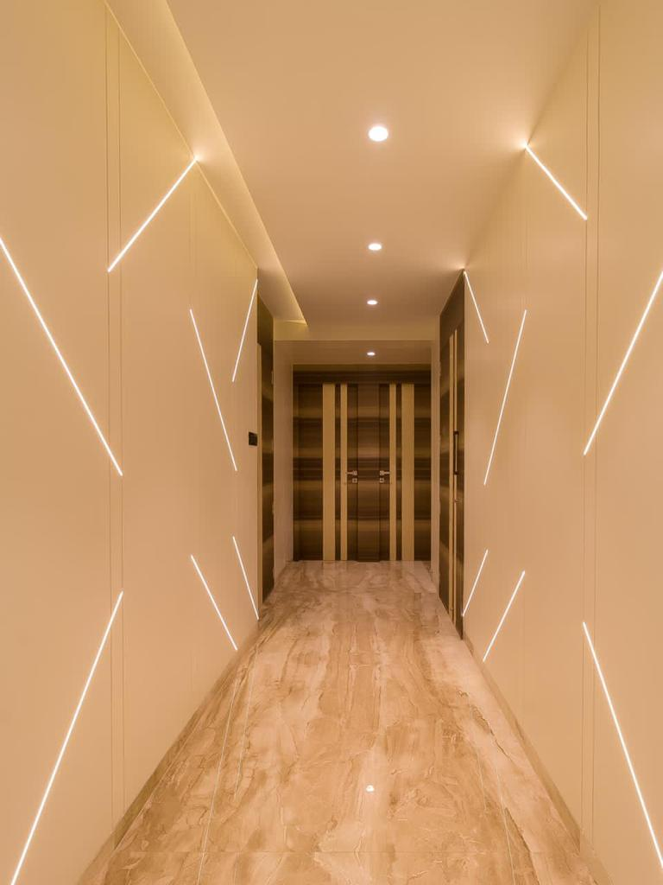

Slide 15
Luxury Residential Interior Design in Mumbai Kalasaar creates modern and elegant interiors that blend functionality with style. From sophisticated living rooms with marble flooring and tufted sofas to contemporary hallways with geometric lighting and stylish corridors with polished stone finishes, every detail reflects our expertise in residential interior design in, Mumbai. Our spaces combine comfort, symmetry, and luxury—crafted to elevate everyday living.

Slide 16
PROJECT 3

Slide 17
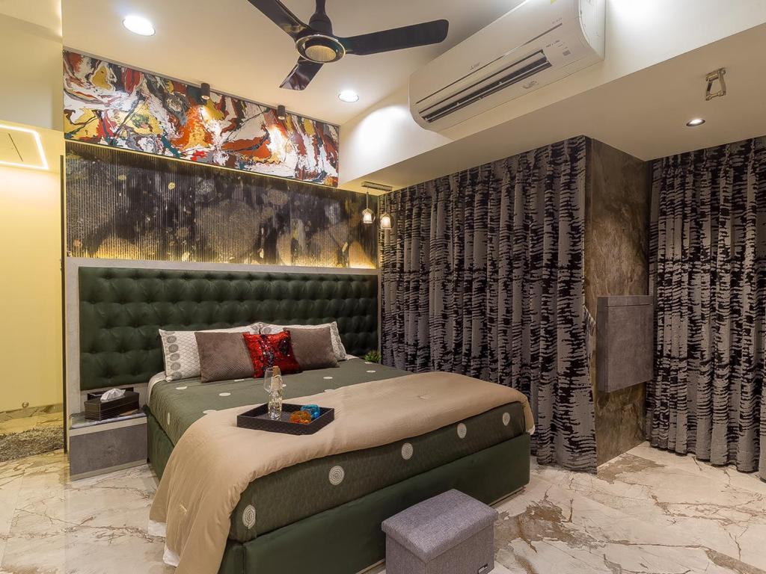

Slide 18
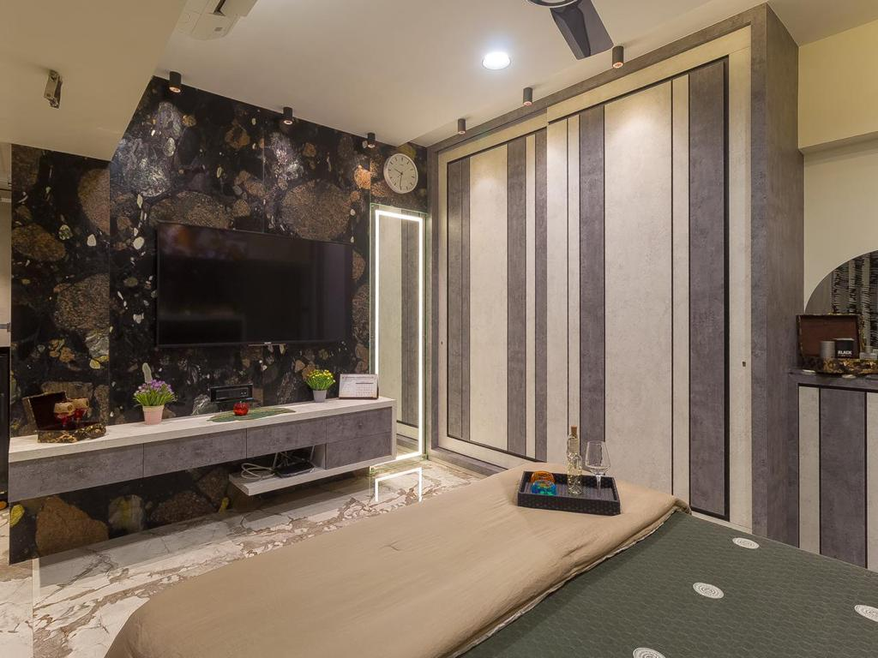

Slide 19
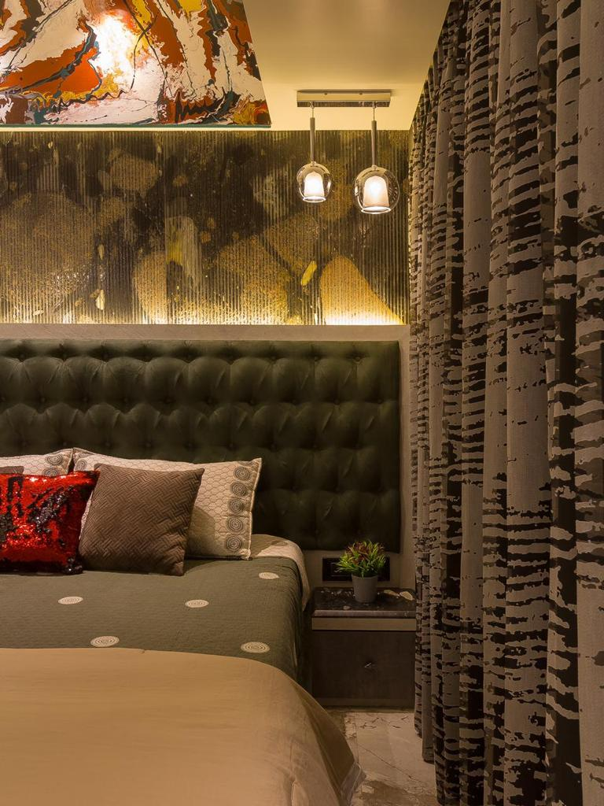
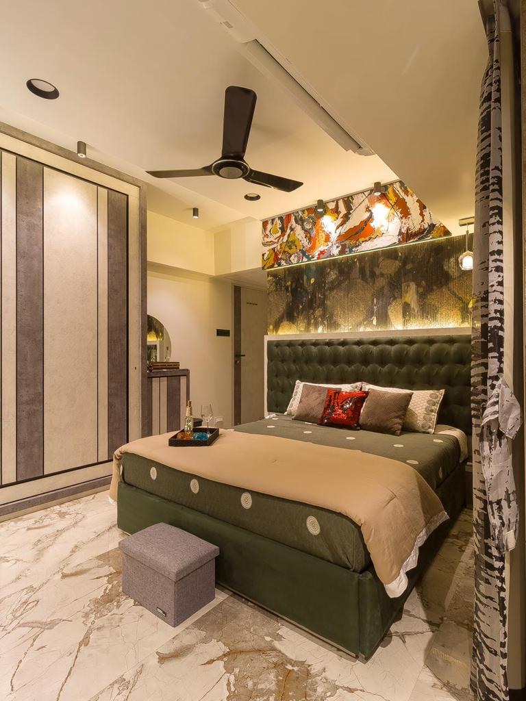

Slide 20
Contemporary Bedroom Interiors Designed for both style and function, this bedroom features a sleek wardrobe with vertical panelling, a textured TV wall, and glossy marble flooring. Ambient lighting, modern décor, and elegant furnishings highlight Kalasaar’s skill in contemporary residential interior design in Mumbai.

Slide 21
PROJECT 4

Slide 22
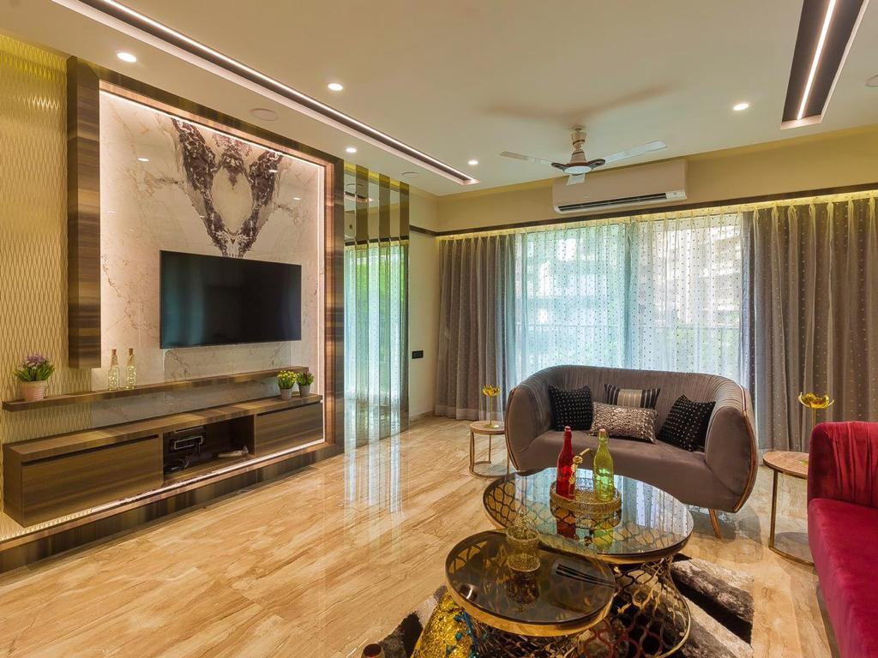

Slide 23
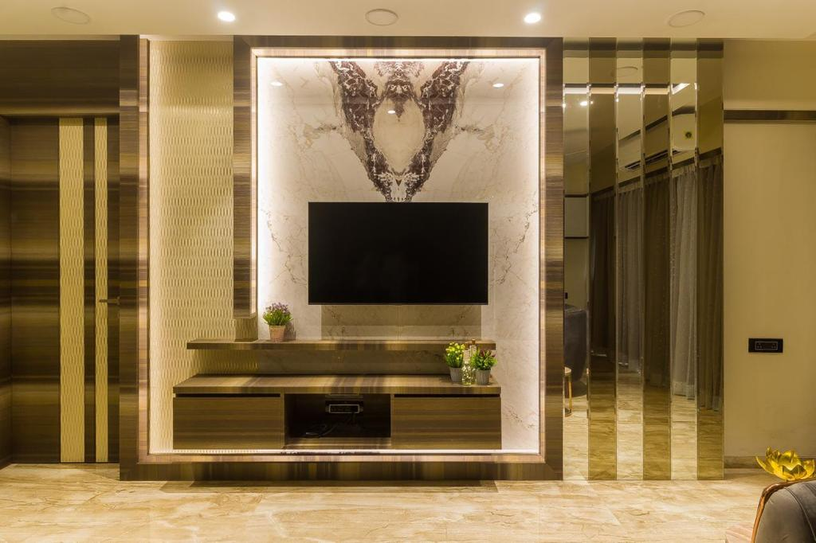

Slide 24
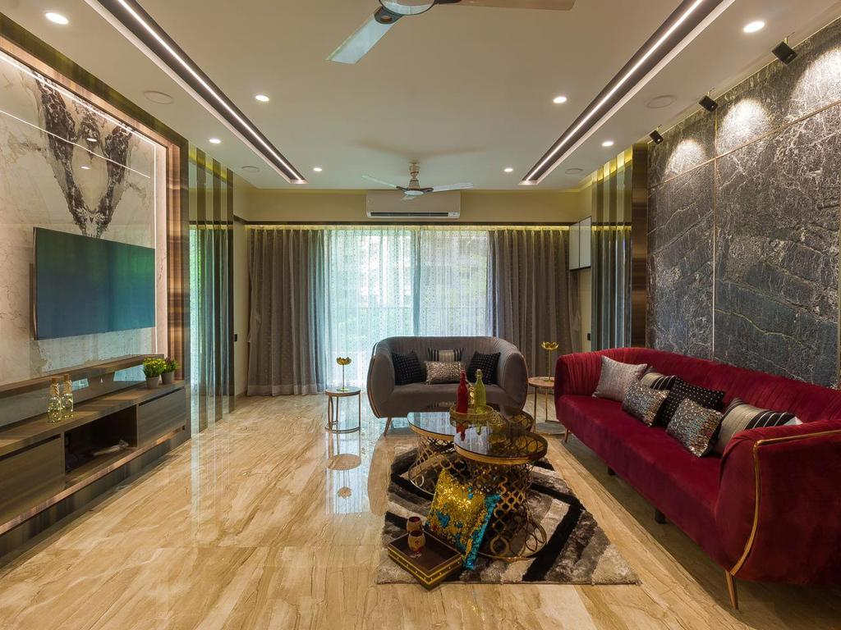

Slide 25
Living Room Interior Discover modern luxury interiors with Kalasaar Interior Design. From elegant living rooms with marble feature walls and plush seating to sophisticated dining spaces with reflective panels and ornate furniture, our designs blend functionality with timeless style. We specialize in residential interior design that enhances comfort, aesthetics, and individuality. Explore our portfolio of contemporary living spaces, entertainment units, and dining areas crafted to elevate your home’s ambiance

Slide 26
PROJECT 5

Slide 27
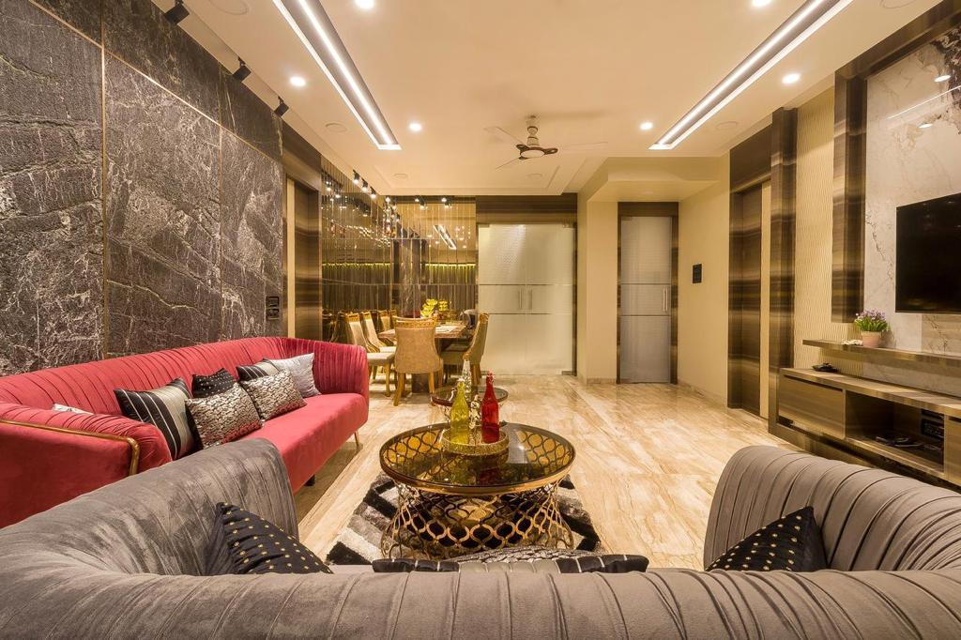

Slide 28
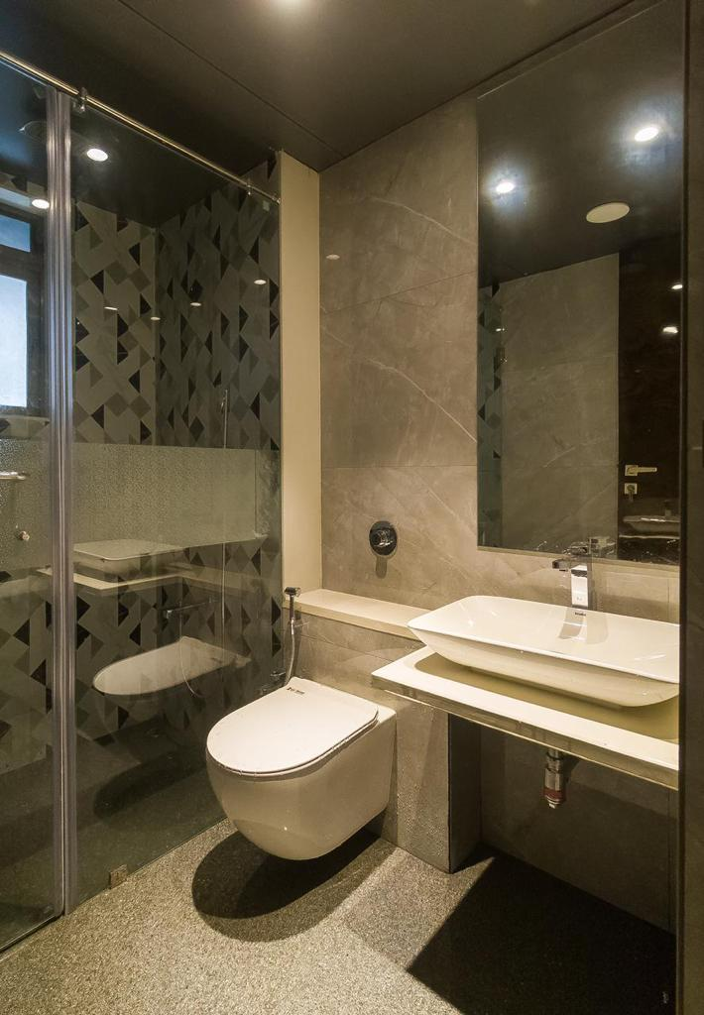
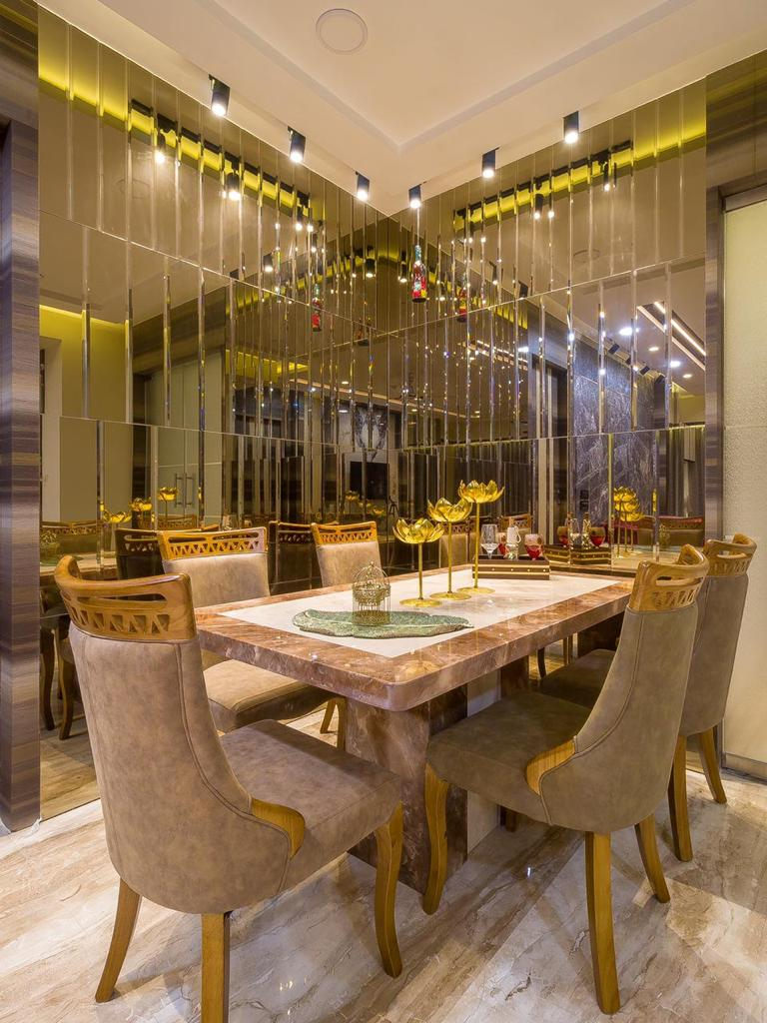

Slide 29
Dining Room Interior
"An opulent dining room featuring a polished stone table, upholstered chairs, and a mirrored accent wall that amplifies space and light. This luxury interior design blends modern finishes with timeless elegance, creating the perfect setting for sophisticated dining."
Bathroom Interior
"A sleek modern bathroom with a wall-mounted toilet, vessel sink, and frosted glass shower enclosure. Designed with minimalist aesthetics and large-format tiles, this contemporary bathroom interior offers both style and functionality."

Slide 30
PROJECT 6

Slide 31
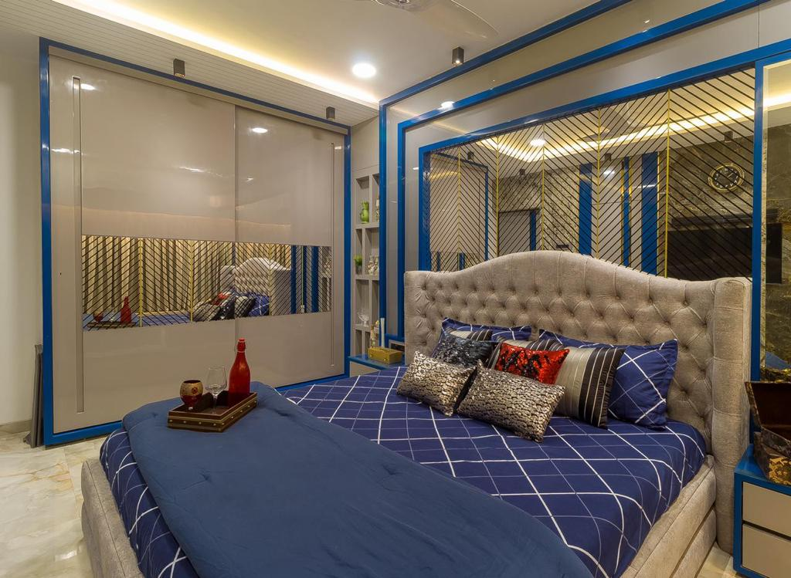

Slide 32
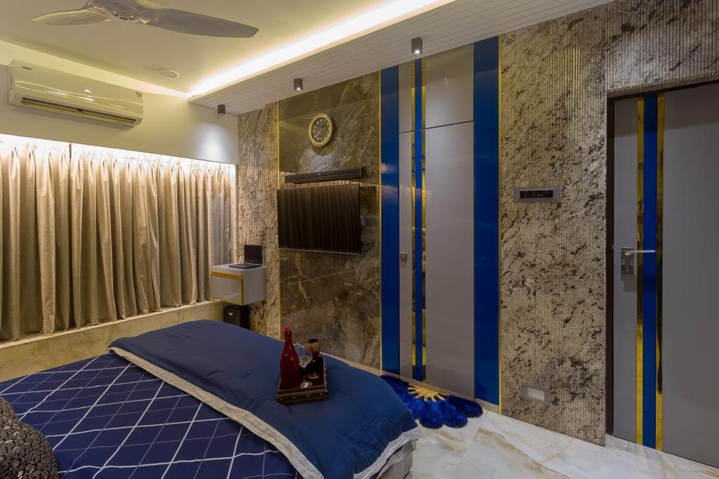

Slide 33
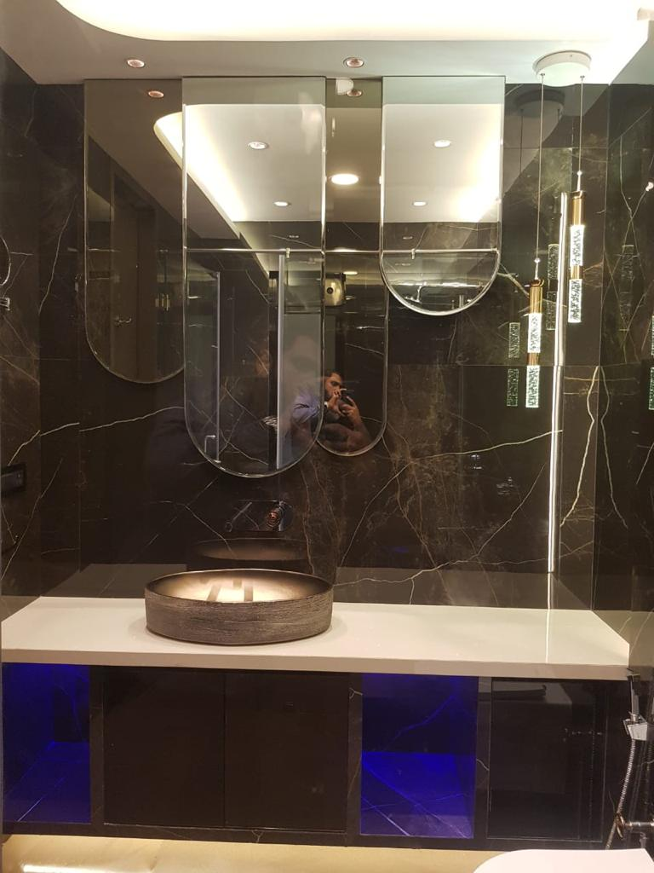
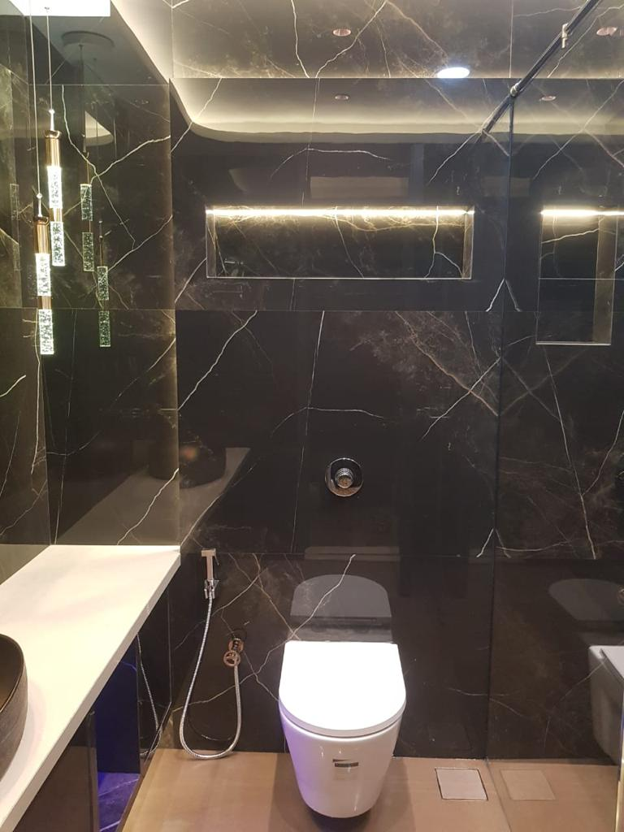

Slide 34
Bedroom Interior
"A luxurious modern bedroom featuring a tufted upholstered bed, navy blue bedding, and elegant decorative accents. Reflective wall panels, marble flooring, and ambient lighting create a warm and inviting atmosphere, blending contemporary style with comfort."

Slide 35
Some more images 3d work

Slide 36
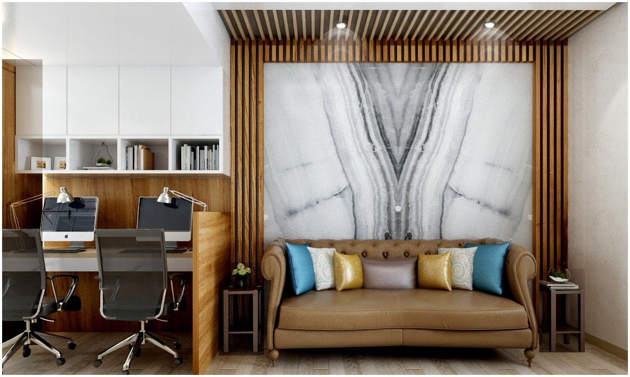

Slide 37
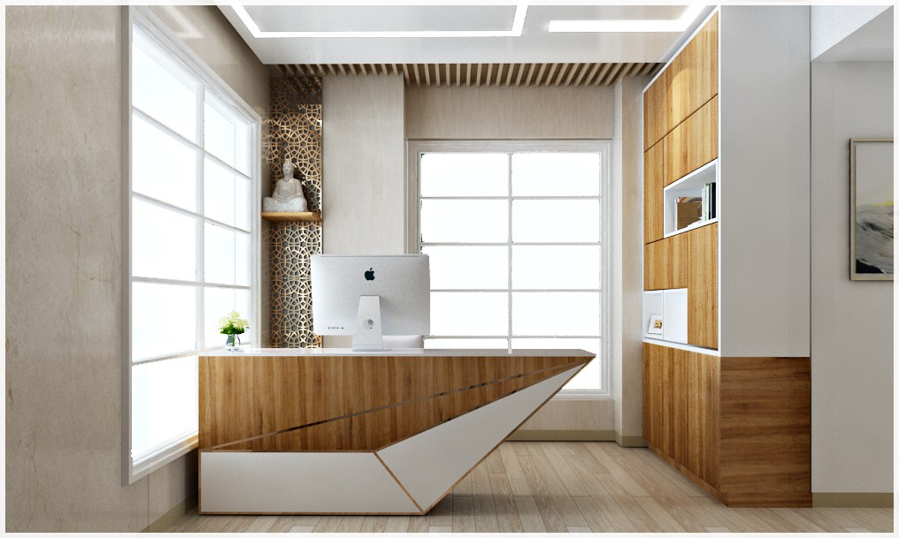

Slide 38
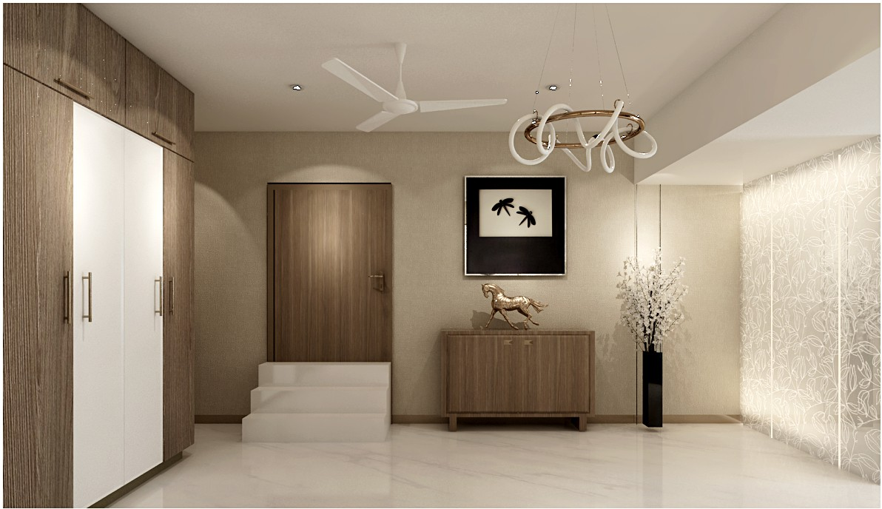

Slide 39
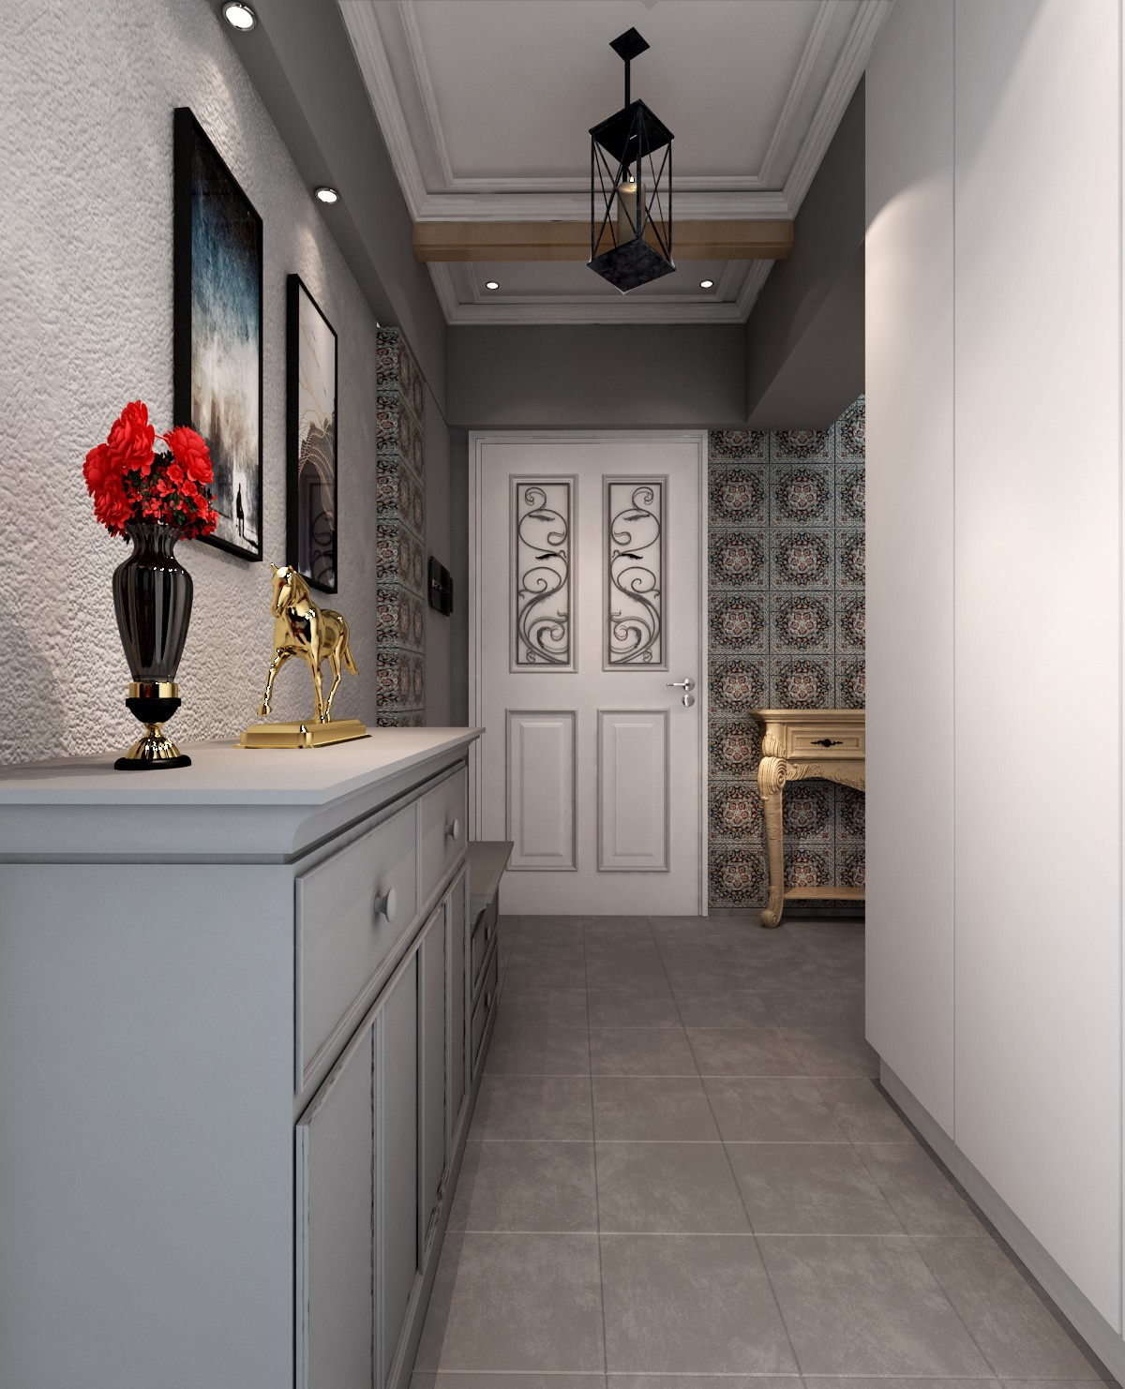
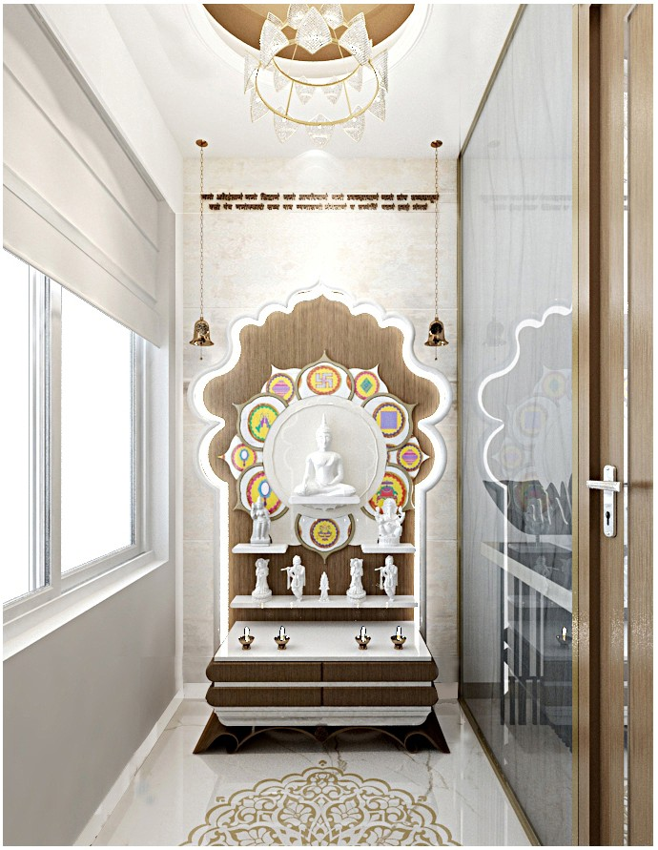

Slide 40
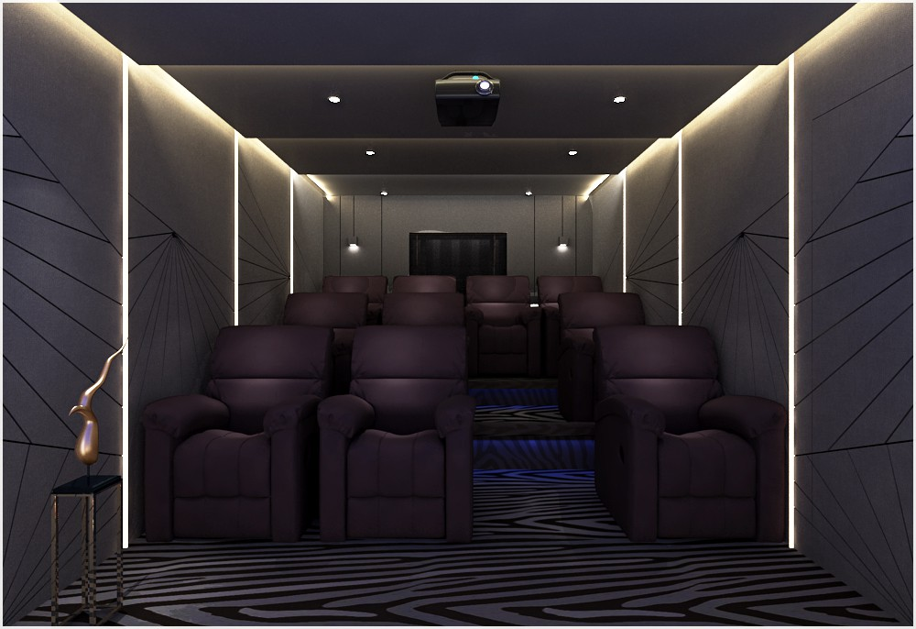

Slide 41
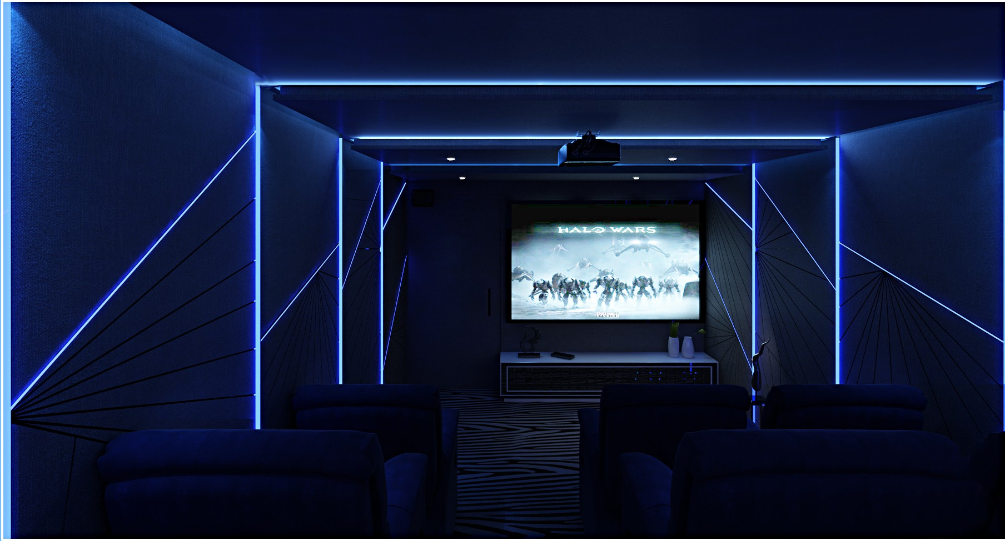

Slide 42
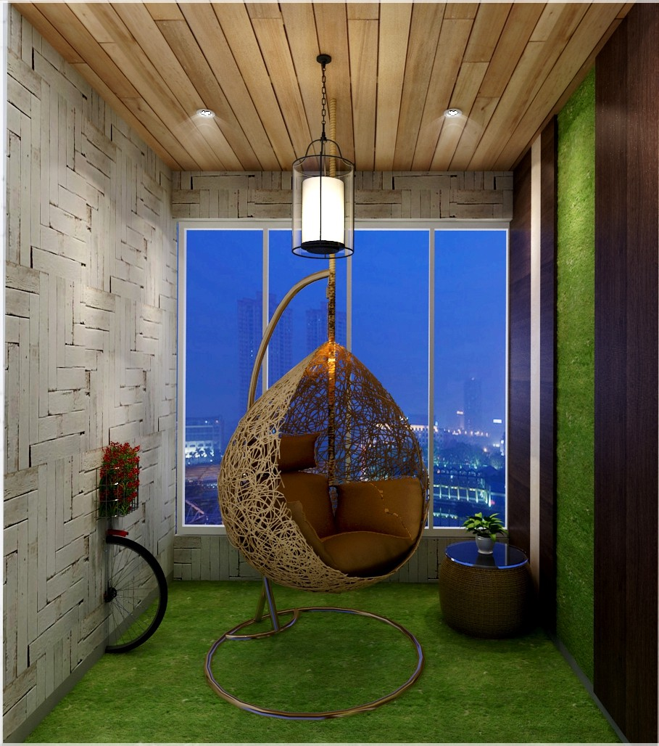
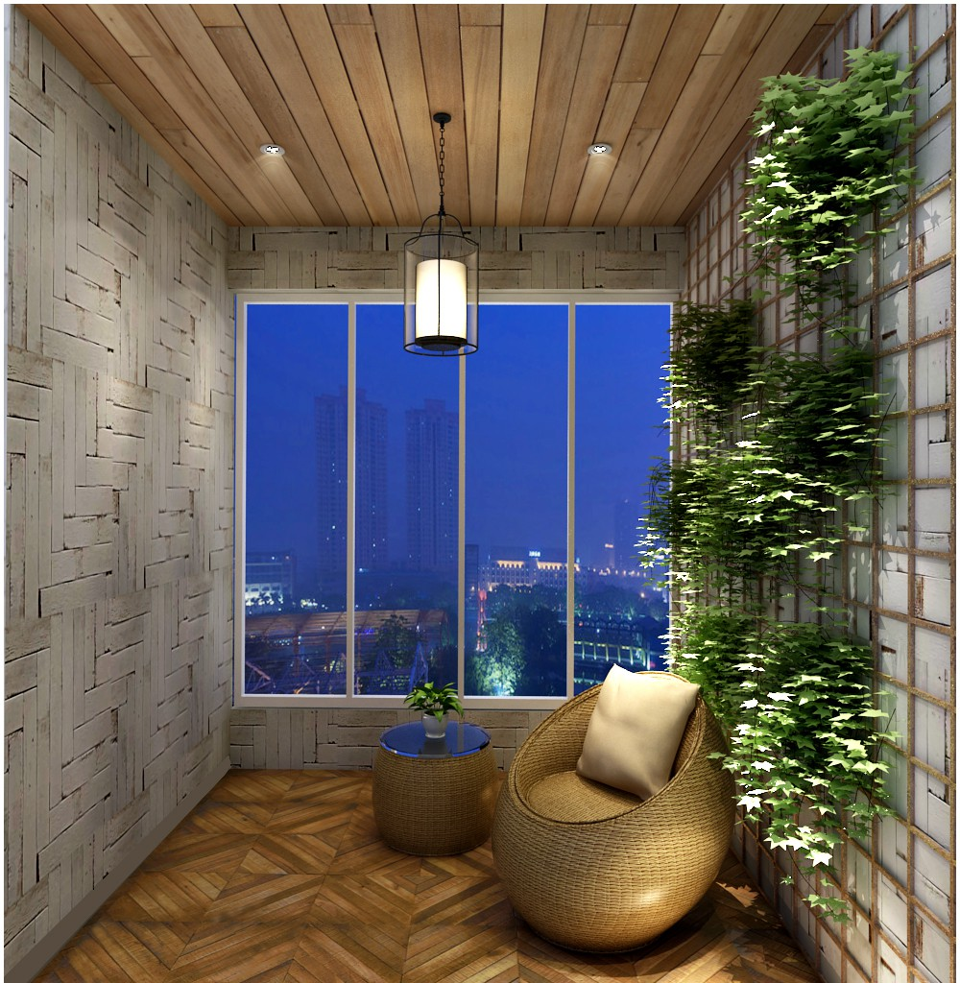

Slide 43
